Slide 1

ONLINE BUS BOOKING MY BUS MY SEAT

Slide 2
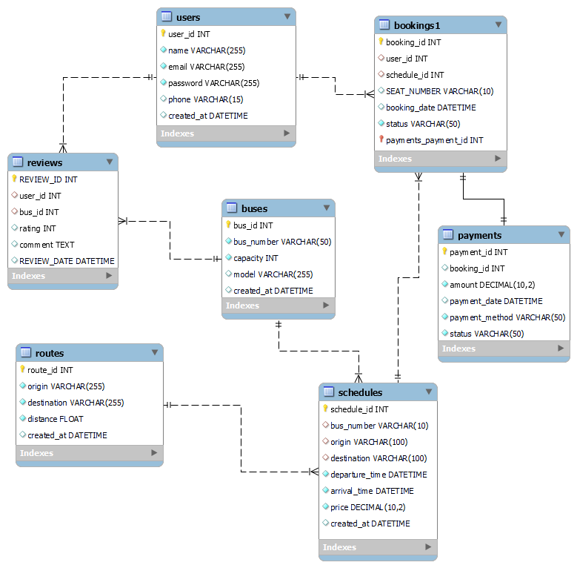
ER- DIAGRAM

Slide 3
RELATIONSHIPS OF TABLES
Users to Bookings: One-to-Many (One user can have multiple bookings)
Buses to Schedules: One-to-Many (One bus can have multiple schedules)
Routes to Schedules: One-to-Many (One route can have multiple schedules)
Schedules to Bookings: One-to-Many (One schedule can have multiple bookings)
Bookings to Payments: One-to-One (One booking can have one payment)
Users to Reviews: One-to-Many (One user can give multiple reviews)
Buses to Reviews: One-to-Many (One bus can have multiple reviews)

Slide 4

STRUCTURE OF TABLES

Slide 5
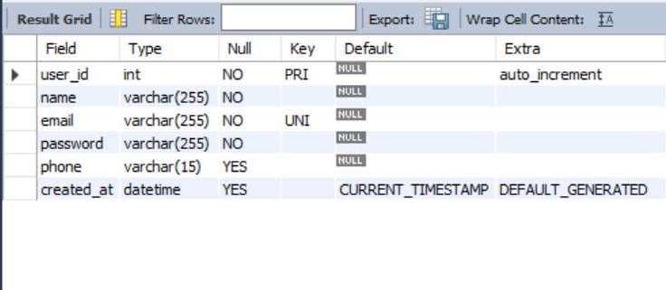
USERS TABLE
This table stores information about users
who book tickets.
SYNTAX: DESC USERS;

Slide 6
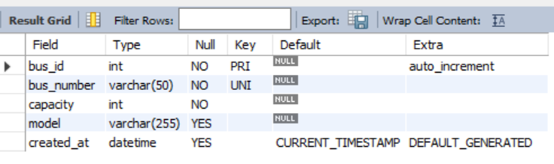
BUSES TABLE
This table stores information about the
buses available for booking.
SYNTAX: DESC BUSES;

Slide 7
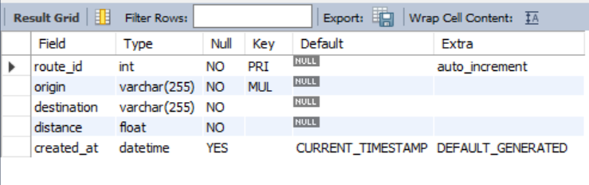
ROUTES TABLE
This table stores information about
the different routes the buses travel.
SYNTAX: Desc ROUTES;

Slide 8
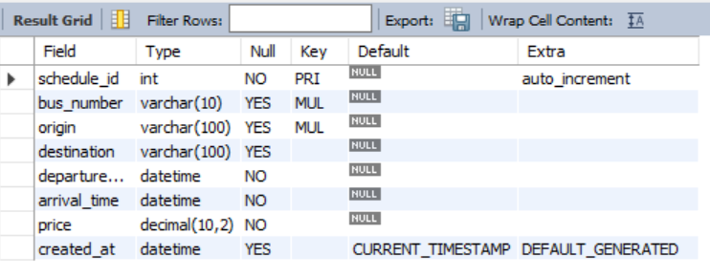
SCHEDULES TABLE
This table stores information about the bus schedules.
SYNTAX: DESC SCHEDULES;

Slide 9
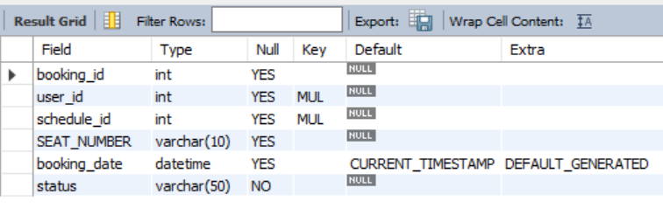
BOOKINGS TABLE
This table stores information about the bookings made by users.
SYNTAX: DESC BOOKINGS;

Slide 10
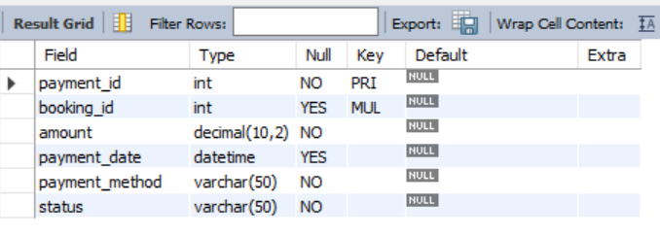
PAYMENTS TABLE
This table stores information about the
payments made for bookings.
SYNTAX: DESC PAYMENTS;

Slide 11
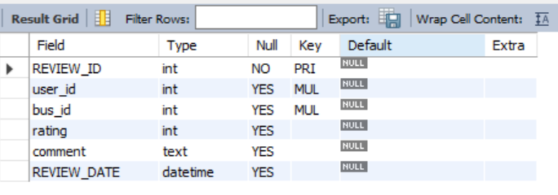
REVIEWS TABLE
This table stores reviews given by users
for bus services.
SYNTAX: DESC REVIEWS;

Slide 12
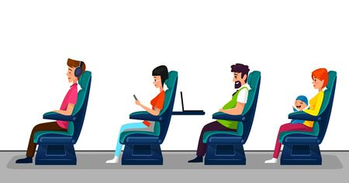
CONTENTS OF TABLES

Slide 13
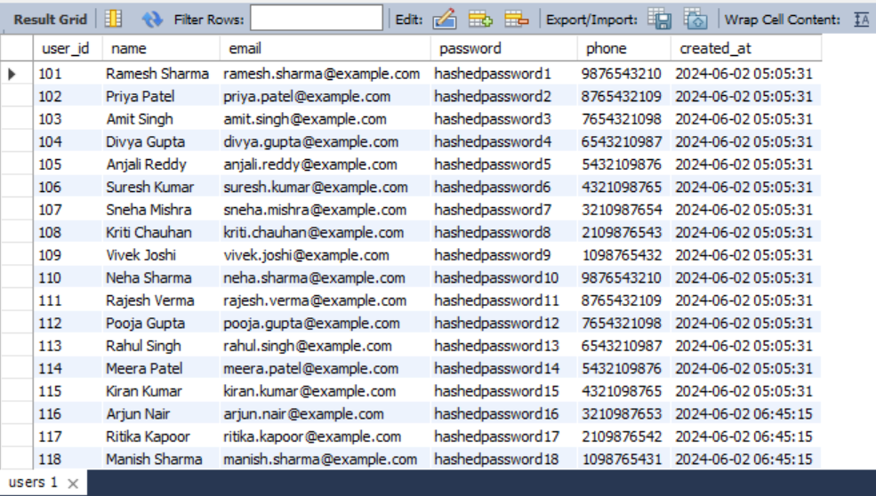
USERS TABLE

Slide 14
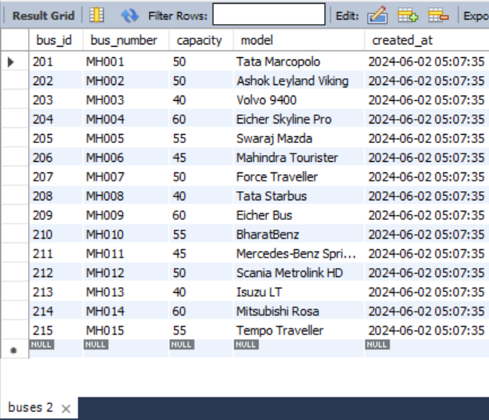
BUSES TABLE

Slide 15
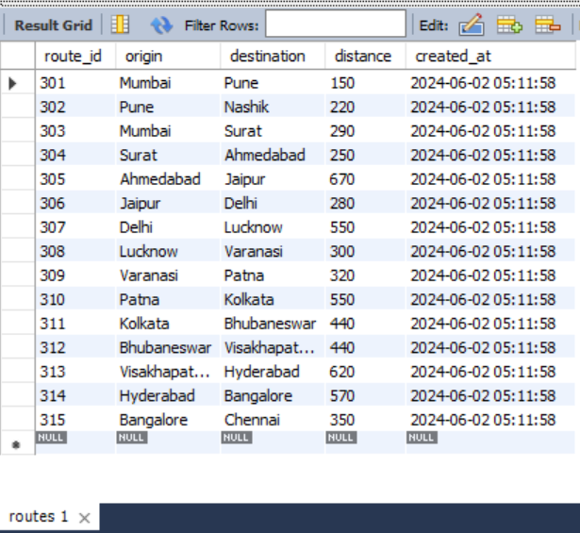
ROUTES TABLE

Slide 16
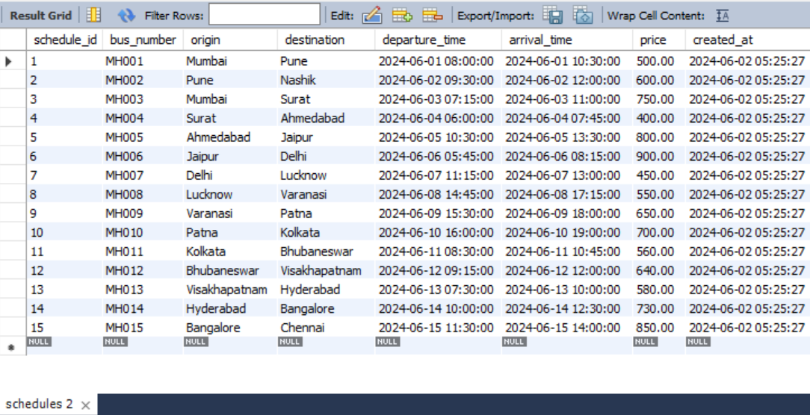
SCHEDULES TABLE

Slide 17
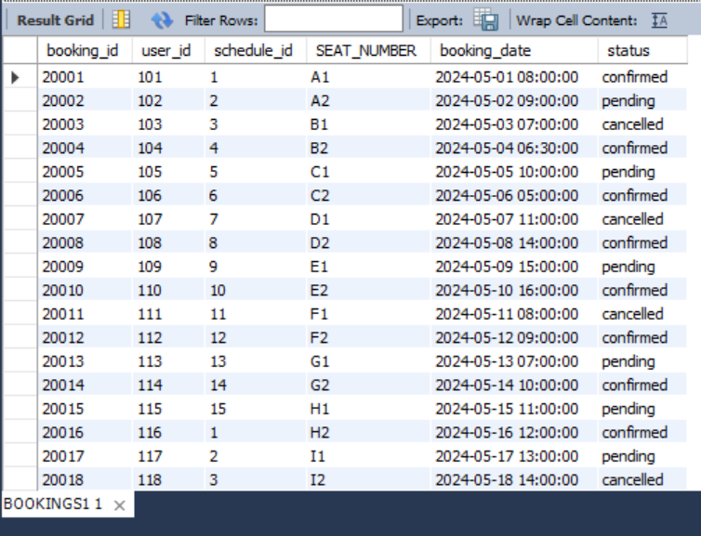
BOOKINGS TABLE

Slide 18
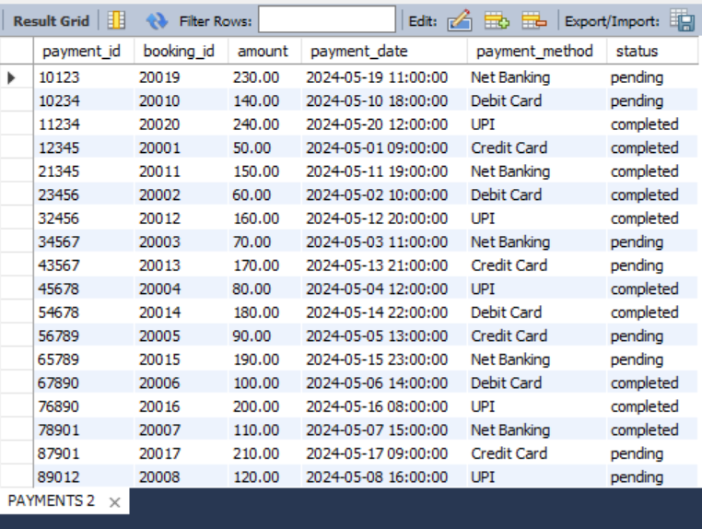
PAYMENTS TABLE

Slide 19
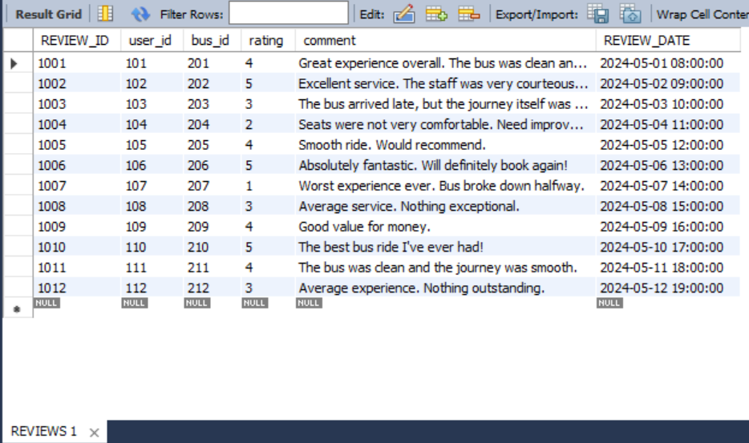
REVIEWS TABLE

Slide 20

SUB QUERIES

Slide 21
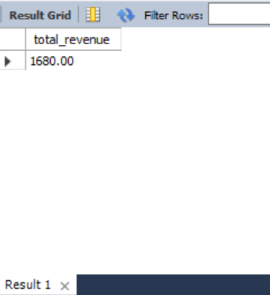
Display total revenue from completed payments
SYNTAX:
SELECT SUM(amount) AS total_revenueFROM PaymentsWHERE status = 'completed';

Slide 22
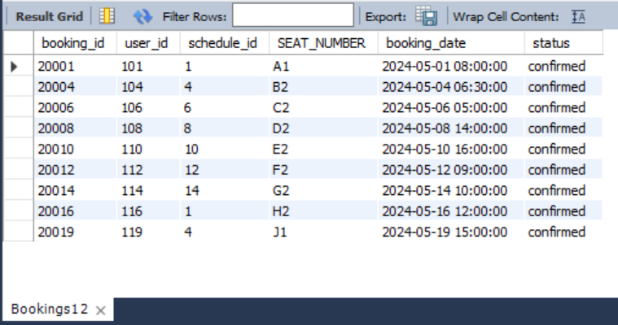
Get Bookings Made by Users who Have Made Payments and Status is Confirmed
SYNTAX:
SELECT *FROM Bookings1
WHERE user_id IN (SELECT DISTINCT
user_id FROM Payments WHERE status =
'completed')AND status = 'confirmed';

Slide 23
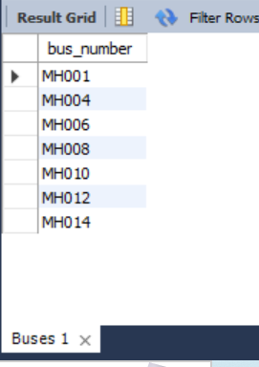
List all buses that have at least one confirmed booking.
SYNTAX:
SELECT DISTINCT bus_numberFROM BusesWHERE bus_number IN ( SELECT bus_number FROM Schedules WHERE schedule_id IN ( SELECT schedule_id FROM Bookings1 WHERE status = 'confirmed' ));

Slide 24
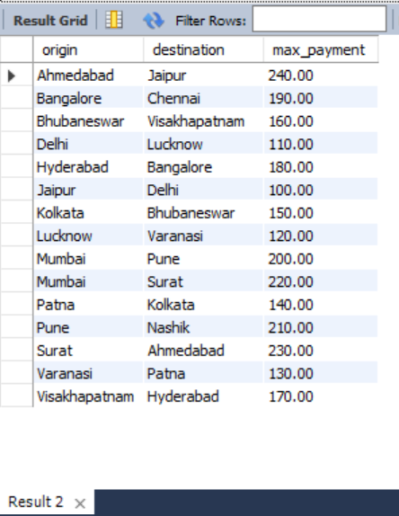
Find the highest payment amount made for each bus route.
SYNTAX:
SELECT origin, destination, ( SELECT MAX(amount) FROM Payments WHERE booking_id IN ( SELECT booking_id FROM Bookings1 WHERE schedule_id IN ( SELECT schedule_id FROM Schedules s WHERE s.origin = r.origin AND s.destination = r.destination ) )) as max_paymentFROM Routes r;

Slide 25
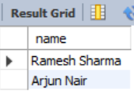
List users who have bookings on buses that travel from 'Mumbai' to 'Pune’.
SYNTAX:
SELECT nameFROM UsersWHERE user_id IN ( SELECT user_id FROM Bookings1 WHERE schedule_id IN ( SELECT schedule_id FROM Schedules WHERE origin = 'Mumbai' AND destination = 'Pune' ));

Slide 26

JOINS

Slide 27
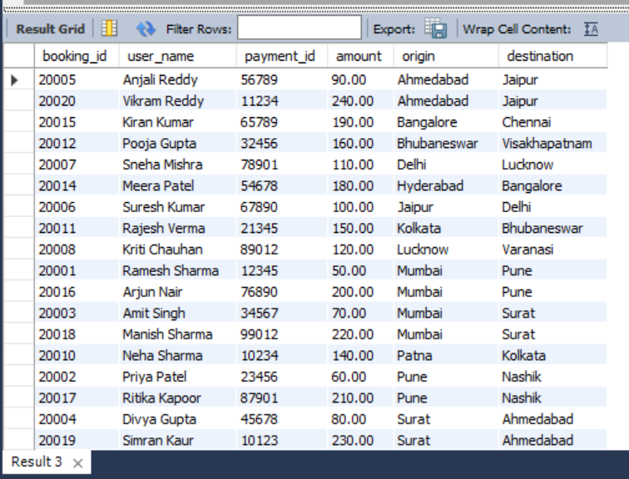
Show Relations of Bookings, Payments, Users, and Origin-Destination of User in Bus Number
SYNTAX:
SELECT
B.booking_id, U.name AS user_name, P.payment_id, P.amount, S.origin, S.destinationFROM Bookings1 B JOIN Users U ON B.user_id = U.user_id JOIN Schedules S ON B.schedule_id = S.schedule_id LEFT JOIN Payments P ON B.booking_id = P.booking_id;

Slide 28
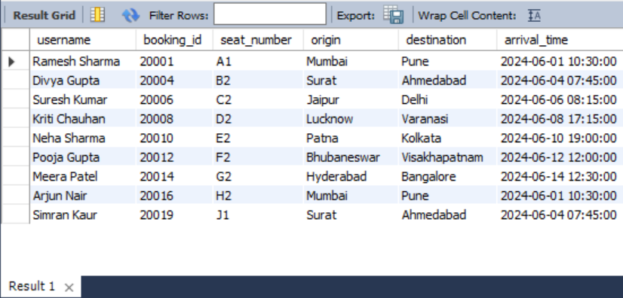
Display the details of bus arrival and seat number to users whose status is confirmed. (LEFT JOIN)
SYNTAX:
SELECT Users.name AS username, Bookings1.booking_id, Bookings1.seat_number, Schedules.origin, Schedules.destination, Schedules.arrival_timeFROM UsersLEFT JOIN Bookings1 ON Users.user_id = Bookings1.user_idLEFT JOIN Schedules ON Bookings1.schedule_id = Schedules.schedule_idWHERE Bookings1.status = 'confirmed'LIMIT 0, 1000;

Slide 29
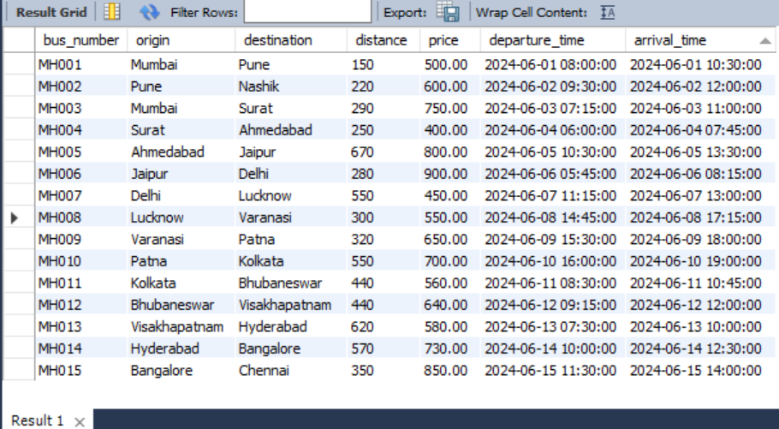
Display the bus schedules along with the routes they cover, including the distance and price of those routes (INNER JOIN)
SYNTAX:
SELECT S.bus_number, S.origin, S.destination, R.distance, S.price, S.departure_time, S.arrival_time FROM Schedules S JOIN Routes R ON S.origin = R.origin AND S.destination = R.destination;

Slide 30
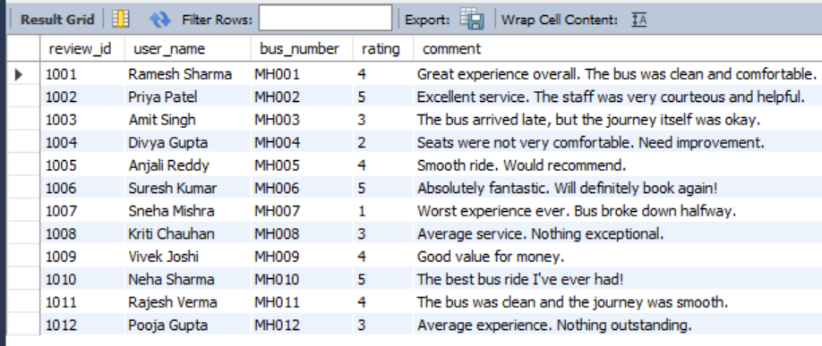
List all reviews and the corresponding user's name and the bus number.
SYNTAX:
SELECT r.review_id, u.name as user_name,
b.bus_number, r.rating, r.comment
FROM Reviews rJOIN Users u ON r.user_id =
u.user_idJOIN Buses b ON r.bus_id = b.bus_id;

Slide 31
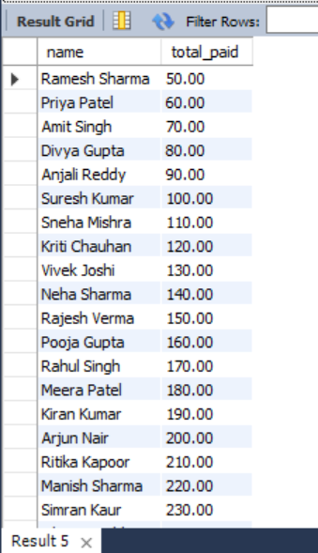
Find the total amount paid by each user.
SYNTAX:
SELECT u.name, SUM(p.amount) as
total_paidFROM Users uJOIN Bookings1 b ON
u.user_id = b.user_idJOIN Payments p ON
b.booking_id = p.booking_idGROUP BY u.name;

Slide 32

THANK YOU

Slide 33

PREPARED BY
KHURPADE NEHA RAMESH
DS/ITVEDANT /T318/02JUNE/3PM-5PM/

